Slide 1

HoSPItality Industry
Hotel Reservation EDA Project
Presented by : Sanket Yadav
Libraries used : Pandas, Numpy, Matplotlib & Seaborn

Slide 2
INTRODUCTION
In the hospitality industry, efficient reservation management plays a crucial role in optimizing hotel revenue and enhancing customer satisfaction. This project involves an exploratory data analysis (EDA) of hotel reservations to identify key patterns, trends, and insights that can help improve business strategies. By analyzing reservation data, we can better understand customer behavior, booking trends, and factors influencing cancellations, no-shows, and revenue generation.

Slide 3
ABOUT THE PROJECT
This project aims to analyze a hotel reservation dataset to uncover insights related to customer bookings, cancellations, revenue patterns, and seasonal trends. The dataset contains various details about hotel guests, including their reservation history, booking status, and financial impact. The analysis will focus on identifying factors affecting hotel revenue, peak booking periods, and reasons behind cancellations and no-shows
Key challenges hotels face:
High cancellation rates – Why do some people book but never show up?
Pricing challenges – How do hotels set the right price at the right time?
Demand Forecasting – Can we predict when hotels will be fully booked?

Slide 4
WORK FLOW
DATA COLLECTION AND UNDERSTANDING
After collecting data it’s very important to understand your data . So we had Hotel reservations analysis data. Which had 5 tables, 2899 rows and 4 to 8 columns in each table.
Data Collection and Understanding
Dataset Overview :
Booking history – Contains information about customers booking history and their status.
Customer details – Contains customers personal information.
Hotels information – Contains information about hotels their name cities and room types.
Reservations – Contains information about hotels reservations.
Room information – Contains information about all rooms and their prices.
Data Cleaning and Manipulation
Exploratory Data Analysis(EDA)

Slide 5
DATASET OVERVIEW
Customer details
Booking history
Customer id- Unique identifier for each customer
First name- First name of the customer
Last name- Last name of the customer
Email- Email address of the customer
Phone number-Contact number of the customer
Address- Residential address of the customer
City- City where the customer located
Country- Country of the customer
Created at-Date when the customer was added to the database
History id- Unique identifier for each booking record
Reservation id- Identifier of the reservation
Status- Status of the booking (e.g., Completed, Cancelled, No-show)
Last updated- Date when the status was last updated
Room Information
Room id- Unique identifier for each room
Hotel id- Identifier of the hotel to which the room belongs
Room type- Type of room (e.g., Single, Double, Suite)
Availability- Whether the room is currently available (Yes/No)
Price per night- Price of the room per night

Slide 6
Reservations table
Hotel information
Reservation id- Unique identifier for each reservation
Customer id- Identifier of the customer who made the reservation
Hotel id- Identifier of the hotel where the reservation was made
Room id- Identifier of the room booked for the reservation
Check in- Date of check-in
Check out- Date of check-out
Total price- Total price for the stay
Booking date- Date when the booking was made
Hotel id- Unique identifier for each hotel
Hotel name- Name of the hotel
Hotel address- Address of the hotel
City- City where the hotel is located
Country- Country where the hotel is located
Rating- Average rating of the hotel (out of 5)
Total rooms- Number of rooms available in the hotel

Slide 7
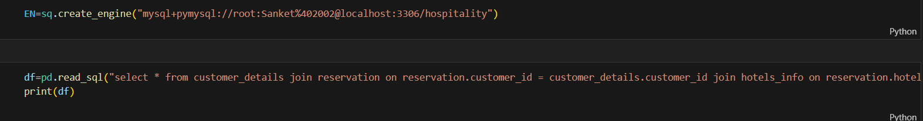
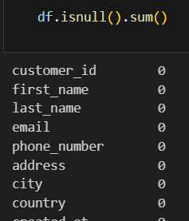
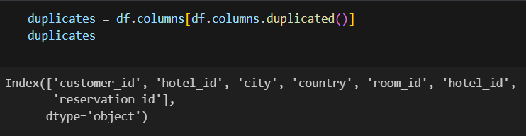
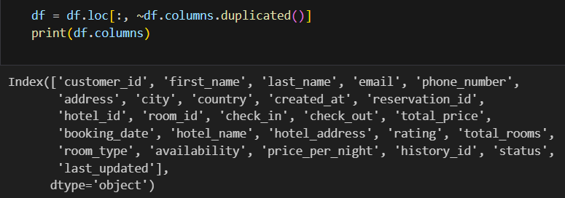
DATA CLEANING AND MANIPULATION
1. First I make SQL connectivity for joining my hotel reservation dataset tables.
2. Finding Null values from dataset.
3. Handling Duplicates
4. Removing Duplicate columns

Slide 8
EXPLORATORY DATA ANALYSIS (EDA)

Slide 9
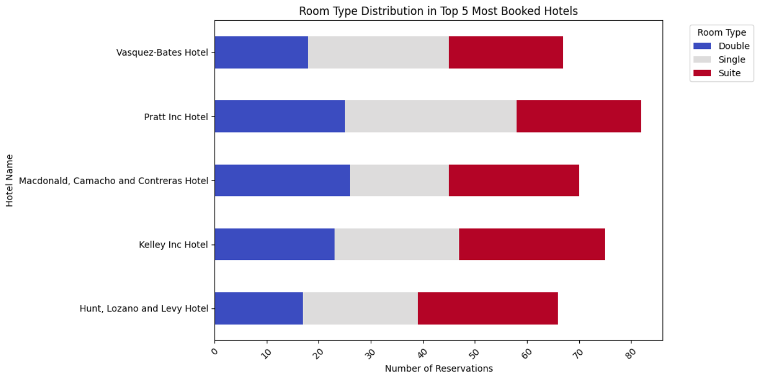
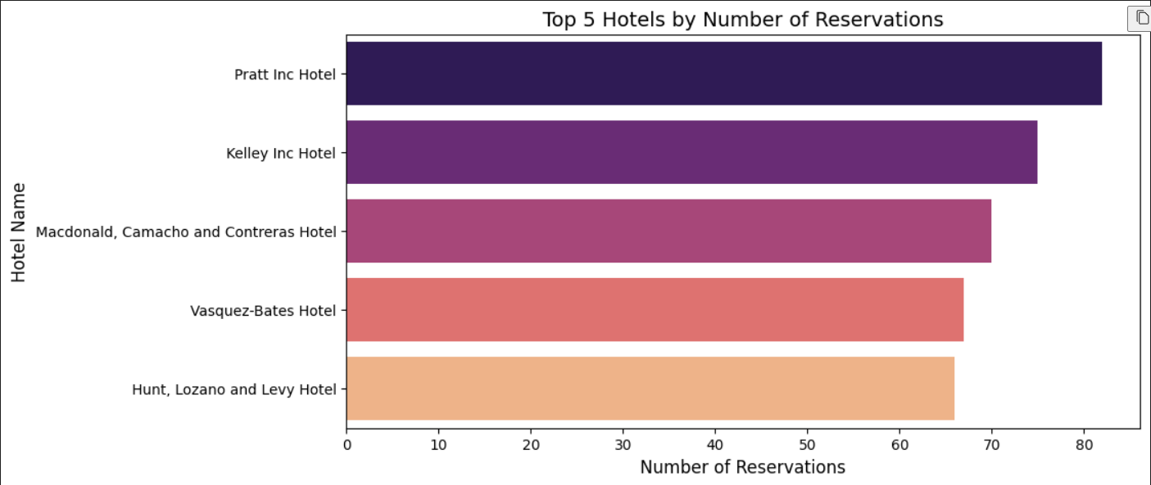
1.Room Type Preference at Top Hotels
Key Insights:
Suit room demand:
Across all the top hotels, the number of suite bookings is consistently high, indicating a strong preference for premium accommodations.
The highest number of suite bookings is at Kelley Inc Hotel (28) & Hunt, Lozano and Levy Hotel (27).
Single room demand:
Pratt Inc Hotel has the highest number of single room bookings (33), suggesting that this hotel attracts solo travelers or business guests more than others.
Double room demand:
Macdonald, Camacho and Contreras Hotel has the highest bookings for double rooms (26), showing a preference for couples or small groups.

Slide 10
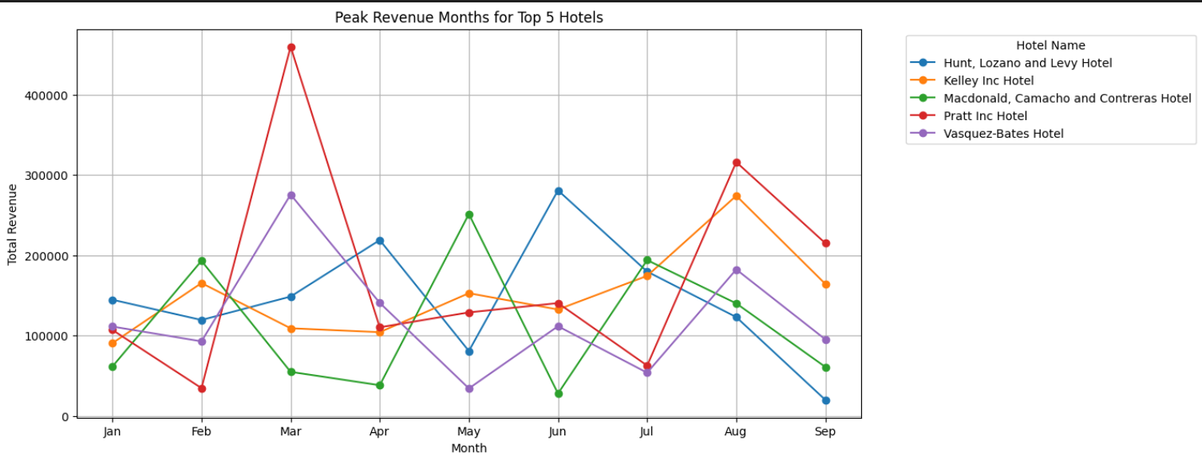
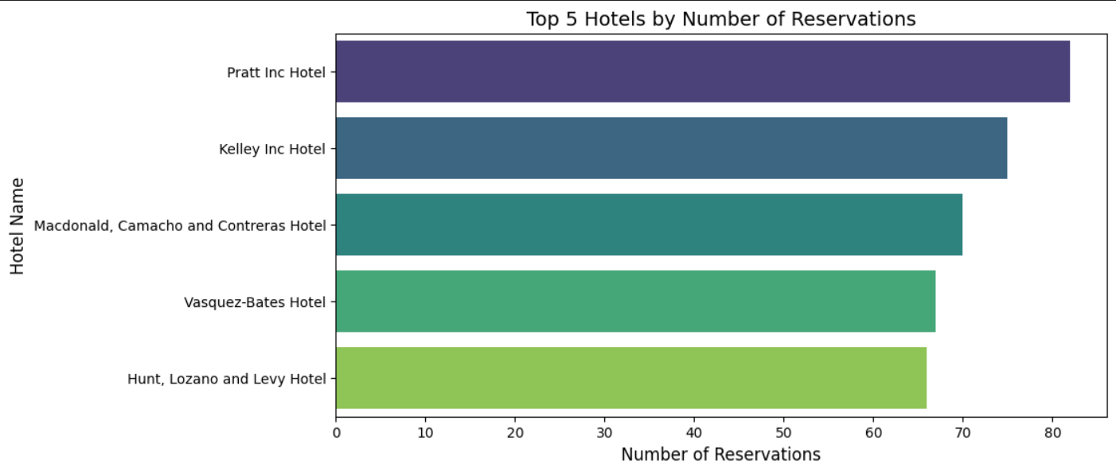
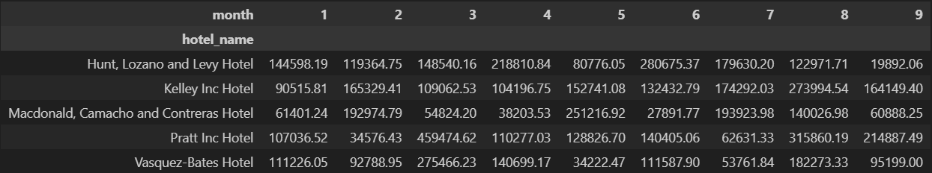
2. Find top 5 hotels and their peak revenue months
Key Insights:
Peak Revenue Months for Each Hotel:
. Hunt, Lozano and Levy Hotel – June ($280,675.37)
. Kelley Inc Hotel – August ($273,994.54)
. Macdonald, Camacho and Contreras Hotel – May ($251,216.92)
. Pratt Inc Hotel – March ($459,474.62)
. Vasquez-Bates Hotel – March ($275,466.23)

Slide 11
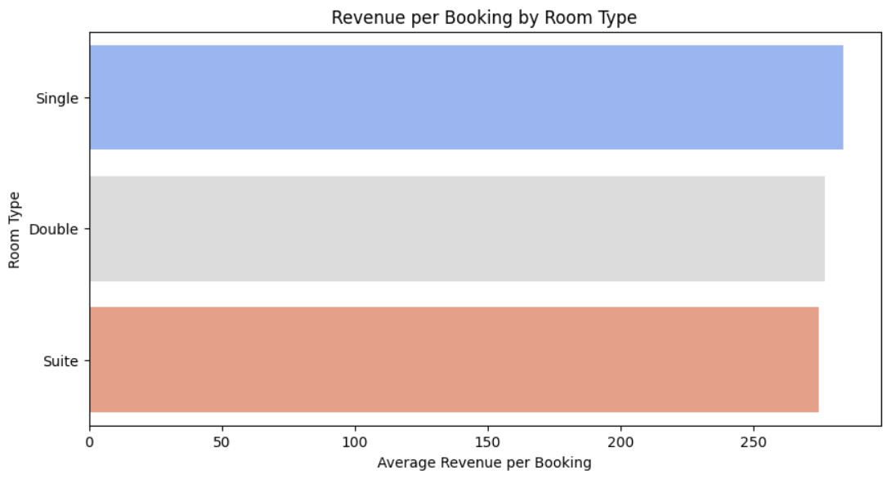
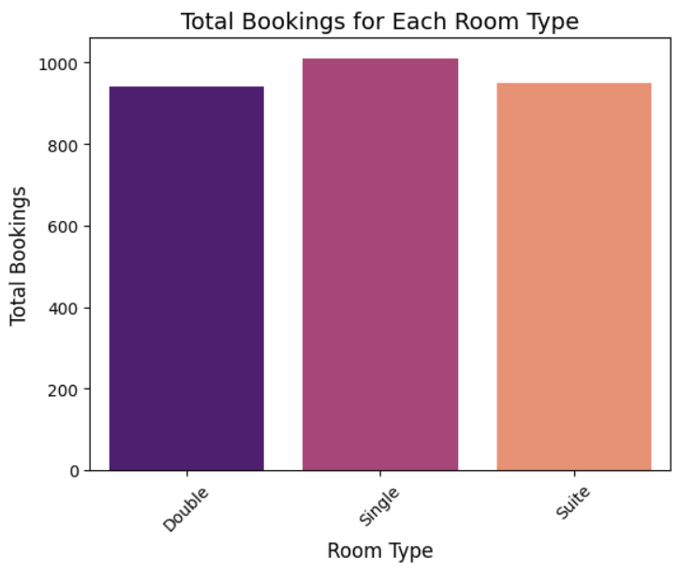
3. Find Revenue per Booking for Each Room Type
Key Insights:
Revenue Variations Across Room Types:
The Single Room generates the highest revenue per booking ($283.59$), followed by Double Room ($276.93$) and Suite ($274.58$).
Suites generate less revenue per booking than Single and Double Rooms, which is unusual since suites are typically considered premium. This may indicate discounting strategies, shorter stays, or lower demand for suites.

Slide 12
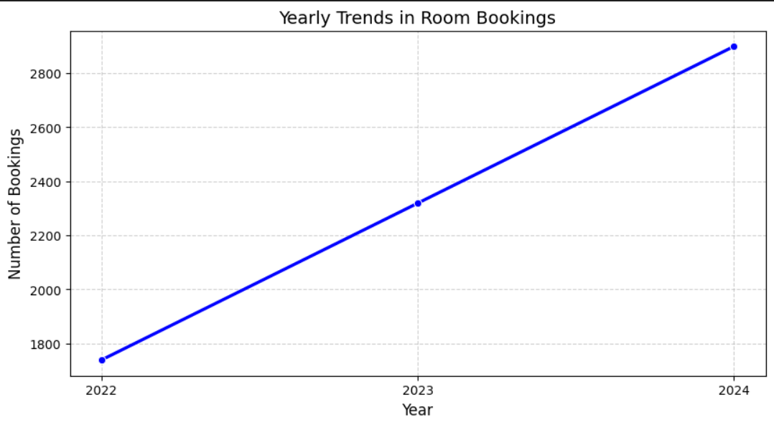
4. YEARLY TRENDS IN ROOM BOOKINGS
Key Insights:
. Steady Growth in Reservations:
2022: 1,739 reservations
2023: 2,319 reservations (33% increase from 2022)
2024: 2,899 reservations (25% increase from 2023)
. Highest Bookings in 2024:
The highest number of reservations occurred in 2024, suggesting that the hotel has been able to attract more customers over time.
This may be due to increased brand awareness, better promotions, or higher customer retention rates
Total Reservations:
2022
1,739 Res.
2023
2,319 Res.
2024
2,899 Res.

Slide 13
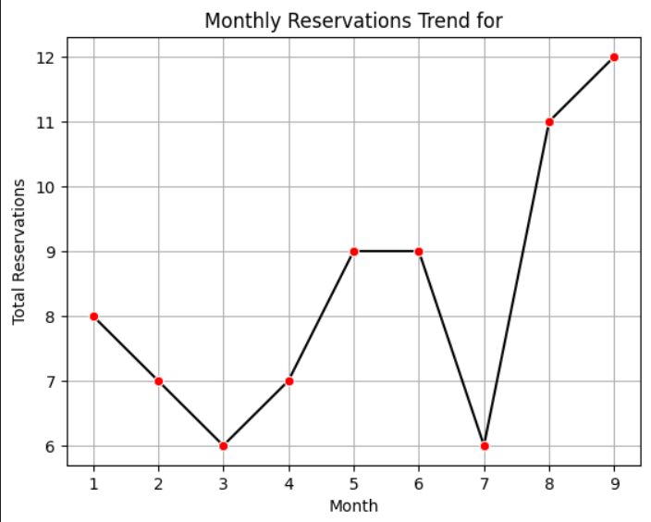
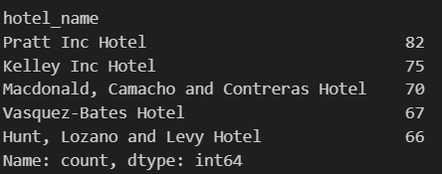
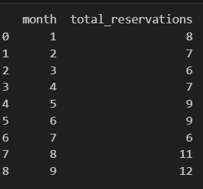
5. which months the reservations are highest for the Kelley Inc hotel
Key Insights:
. Peak Reservation Months:
The highest number of reservations occurred in September (12 reservations) and August (11 reservations).
. Moderate Booking Months:
May and June recorded 9 reservations each, suggesting a steady flow of bookings during mid-year.
February and April had 7 reservations each, indicating consistent but slightly lower demand.
. Low Reservation Months:
March (6 reservations) and July (6 reservations) had relatively fewer bookings.

Slide 14
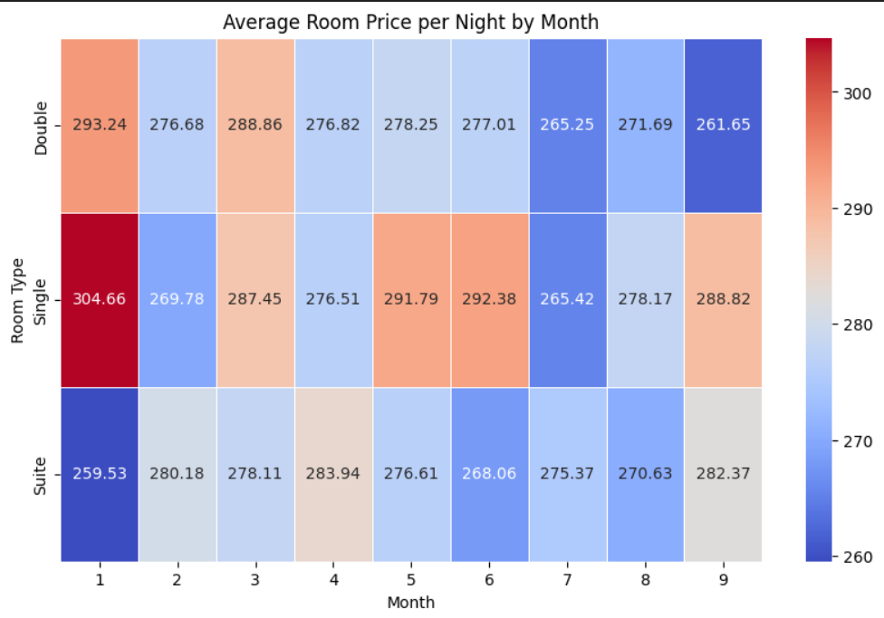
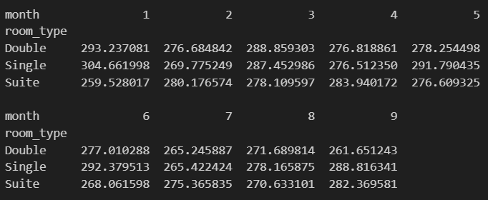
6.Find how room prices fluctuate in different months
Identify peak and off-peak season pricing
Key Insights:
Peak Season Pricing (Higher Prices)
Double room : Higher price is (293.24) in January and March (288.86)
Single room : Higher price is (304.66) in January and June (292.38)
Suite room : Higher price is (282.37) in September and February (280.18)
Off Season Pricing (Lower Prices)
Double room : Lower prices is (261.65) in September
Single room : Lower price is (265.42) in July
Suite room : Lower price is (259.53) in January

Slide 15
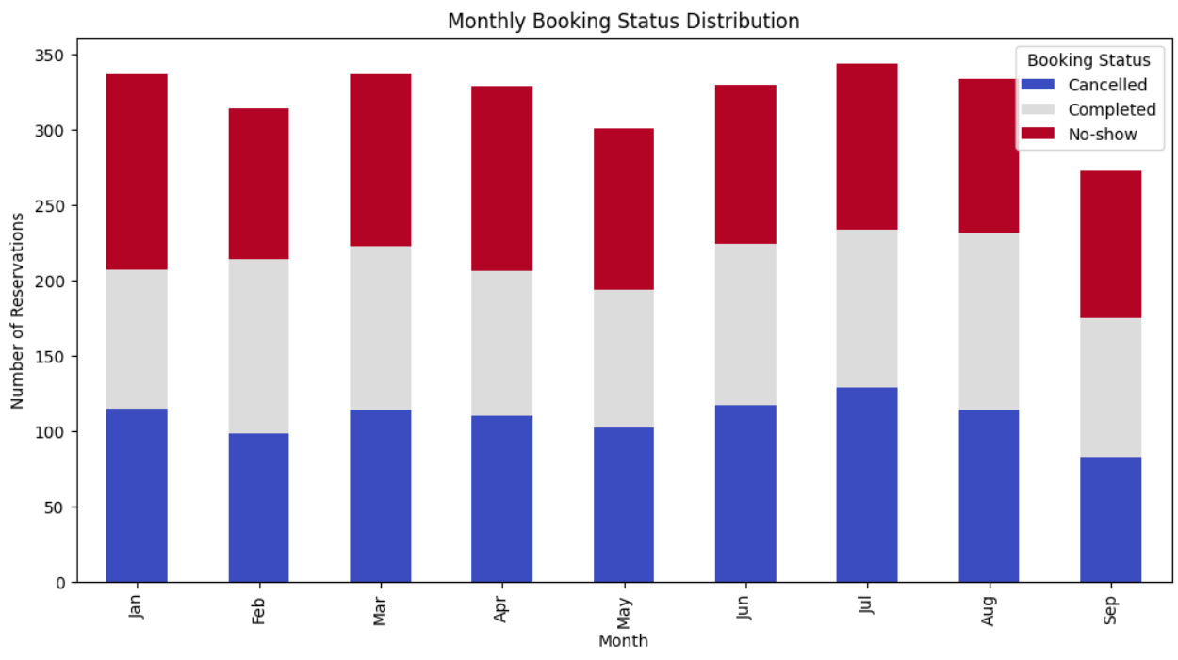
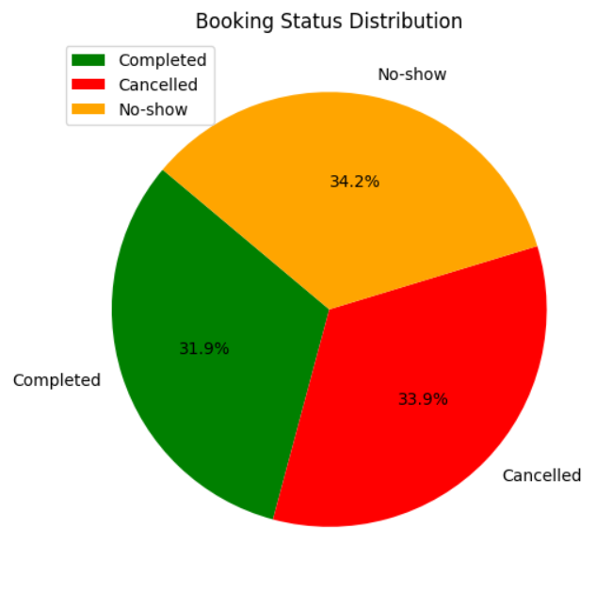
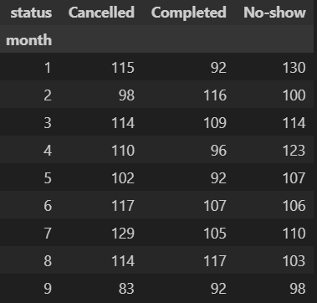
7. Seasonal Trends in booking status
Key Insights:
Cancellations peak in July (129) and June (117), while the lowest cancellations occur in September (83).
No-shows are highest in January (130) and April (123), while September has the lowest (98).
Completed bookings are highest in August (117).

Slide 16
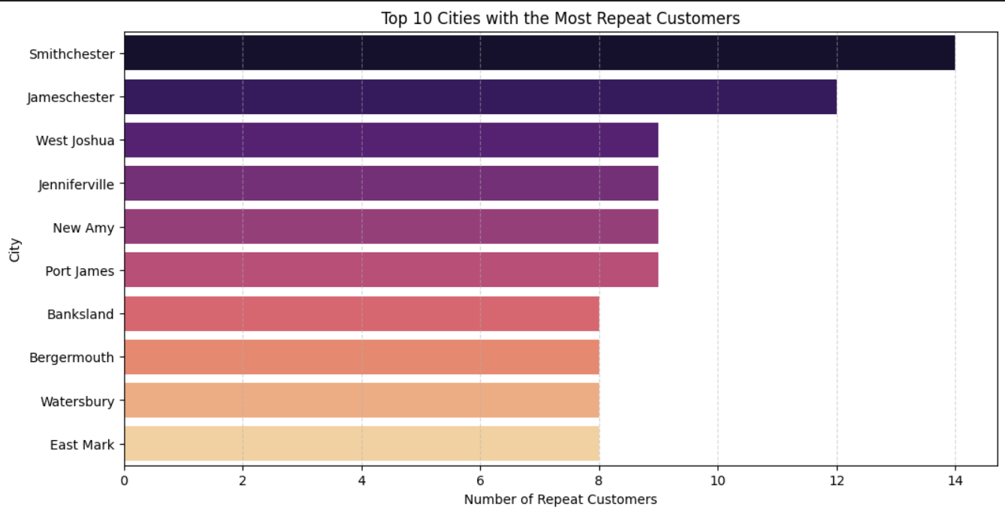
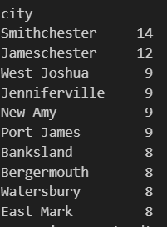
8.Popularity Among New vs. Returning Customers
Find if top cities are attracting repeat guests or new visitors
Key Insights:
. Cities like Smithchester and Jameschester (which have the highest count) have a higher proportion of returning customers, it could indicate customer loyalty or frequent business travelers.

Slide 17
BUSINESS RECOMMENDATIONS
Reduce cancellations – Encourage customers to make advanced payments or offer rebooking options.
Optimize pricing strategies – Use dynamic pricing to adjust rates based on demand.
Target the right customers – Offer loyalty discounts to returning guests.
Use last-Minute deals – Fill vacant rooms by providing special discounts for same-day bookings.

Slide 18
CONCLUSION
The analysis of the hotel reservations dataset reveals that booking patterns are influenced by seasonality, customer behavior, with a significant number of cancellations occurring due to long lead times. Understanding these trends can help hotels improve their pricing strategies, implement better cancellation policies, and optimize revenue management to enhance overall efficiency and customer satisfaction.

